Slide 1



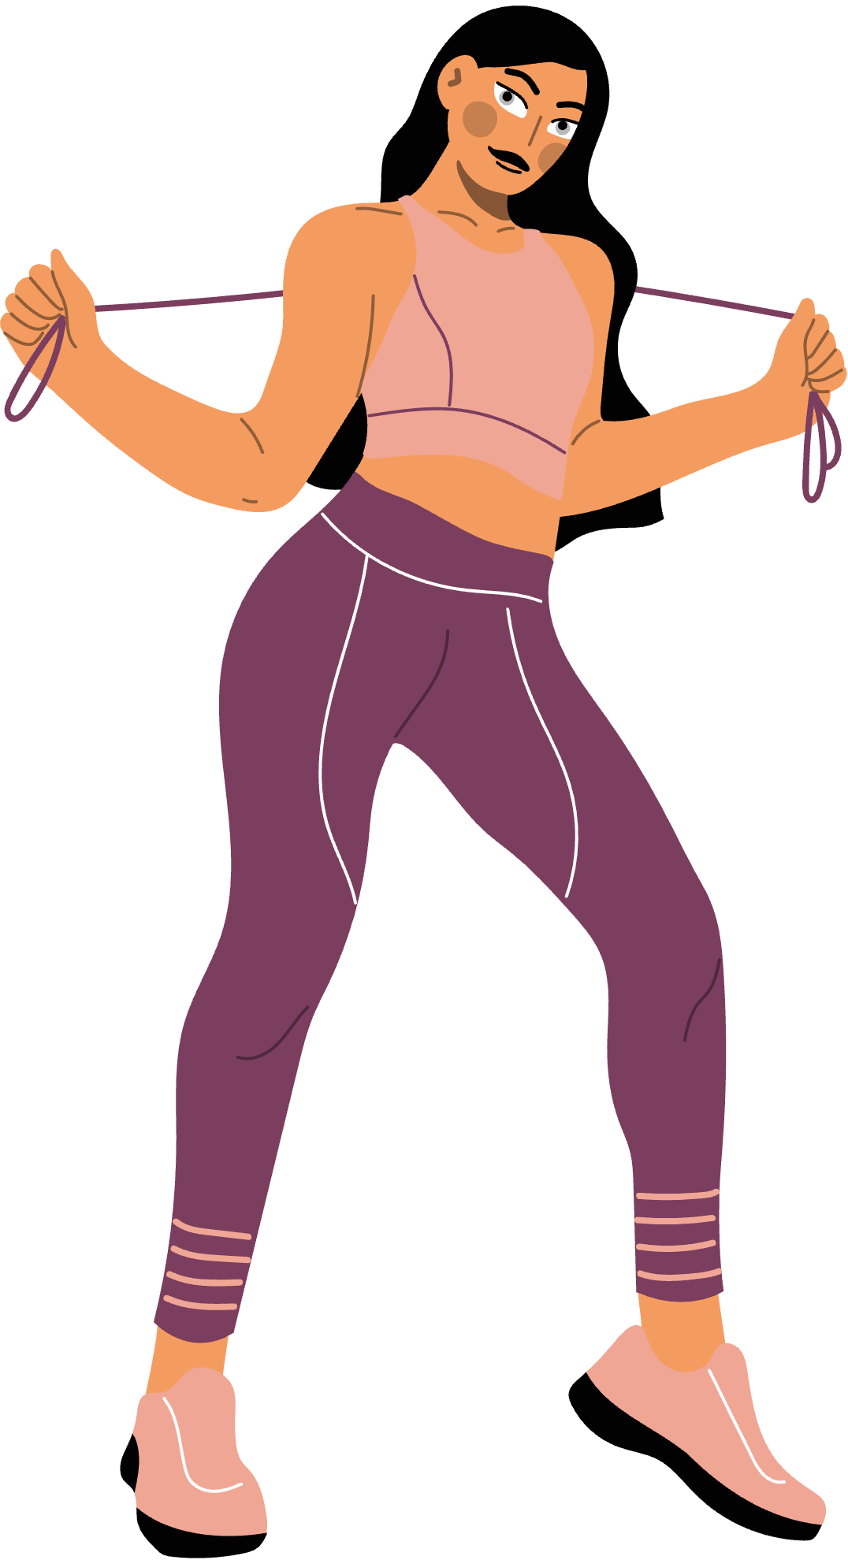
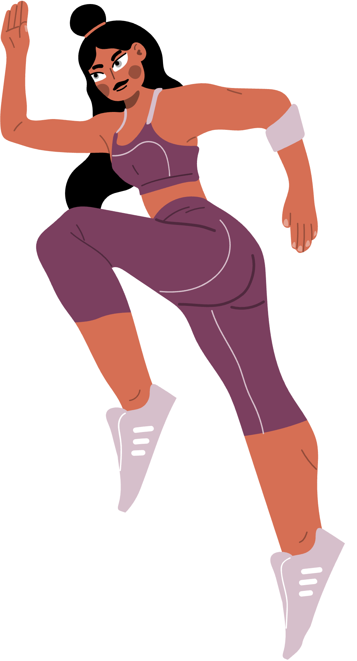
MSAI- 495: Computer Vision
Pose2Reps: Automated Rep Counter
Pathways to a Healthier Lifestyle
Shruti Kalaskar | Divyanka Thakur
Youtube Link
Notes:
Slide 1: Title Slide – Pose2Reps: Automated Rep Counter
Script:
Hello everyone, my name is Shruti Kalaskar, and I’m excited to present our project Pose2Reps: An Automated Rep Counter Using Computer Vision.
I collaborated with Divyanka Thakur on this project as part of the MSAI-495 Computer Vision course at Northwestern University.
Our primary goal was to create a vision-based fitness tracking system that can automatically count repetitions in exercise videos without needing any wearable sensors or human supervision.
In a world where health and fitness are increasingly monitored by smart devices, we wanted to explore a lightweight, camera-only approach that works just from video footage.
The motivation stemmed from wanting to help users — especially beginners — get consistent, measurable feedback while exercising at home, without relying on expensive gym equipment or wearable tech.
Pose2Reps serves as a proof of concept for how computer vision, when combined with simple logic and thoughtful design, can provide meaningful, real-time fitness feedback.

Slide 2




Why Automate Exercise Tracking?
Eliminate Manual Effort: No need to count reps or log workouts — automation ensures accuracy without user intervention.
Real-Time Feedback: Enables instant insights into performance
Sensor-Free Convenience: Vision-based systems work with just a camera — no wearables or external devices required.
Notes:
📌 Slide 2: Why Automate Exercise Tracking?
Script:
Before jumping into the technical aspects, we first asked ourselves: why automate exercise tracking in the first place?
We found three major pain points that current workout tracking systems either ignore or complicate:
First — Manual effort.
Think about your last home workout. Did you forget how many pushups you’d done mid-set? Most people do. We don’t want users counting reps while they’re trying to focus on their form or breathing. Automation removes that burden.
Second — Lack of real-time feedback.
Many current fitness apps analyze movement after the workout is complete. But what if you could get feedback as you're doing each rep — almost like having a personal trainer right there? That’s the kind of responsiveness we aim to enable.
Third — Sensor-free accessibility.
Wearable devices like FitBits or Apple Watches can be helpful, but they’re not always accurate for bodyweight workouts and aren't available to everyone. Pose2Reps only requires a standard camera — making it low-cost and widely deployable.
With these three goals — remove mental load, enable instant feedback, and ensure accessibility — we built our system.

Slide 3


System Overview
Input: Workout video
Pose Estimation: YOLOv11 pose model detects keypoints
1
2
Joint Angle Calculation
Rep Counting Logic
4
3
Output
5
Notes:
🧠 Slide 3: Proposed System Overview
Script:
Now let’s look at how Pose2Reps actually works behind the scenes.
The system takes in a simple video input — currently we’ve worked with two types of exercises: pushups and lunges.
For each frame of the video, we apply a YOLOv11s pose estimation model. This model predicts the position of 17 joints — such as elbows, knees, shoulders, and ankles — for every person in the frame.
From these keypoints, we calculate specific joint angles — for example, the angle at the elbow during a pushup, or the angle at the knee during a lunge.
These angles help us identify key postures in the movement — like when you’re at the bottom of a pushup or when you’ve stood back up from a lunge.
We then use a state-based approach — essentially looking for transitions like “down to up” — to count a single rep.
The best part? At the end of the video, the system automatically overlays a summary screen that shows:
The total number of reps
XP earned (we use 10 XP per rep as a gamified feedback loop)
An estimate of calories burned
This summary turns raw movement into insights — and can motivate users to improve.

Slide 4
Pose Estimation using YOLOv11s
MODEL SELECTION
We use the YOLOv11s-Pose model for fast, real-time pose estimation with 17 keypoints (shoulders, elbows, knees)
EfficiENCY FOCUS
Chosen over YOLOv11-m/l for its lighter footprint and better performance
Preprocess: 2.5–4.7 ms | Inference: ~325–375 ms | Postprocess: ~1–2 ms
SpeED PERFORMANCE
REAL-TIME SUITABILITY
Ensures lag-free tracking, ideal for frame-by-frame exercise monitoring
Notes:
🕵️ Slide 4: Pose Estimation Using YOLOv11s
Script:
Our system relies on pose estimation, and we chose YOLOv11s for this task because of three key factors: speed, accuracy, and lightweight deployment.
Let’s break it down:
The Backbone is CSPDarknet-Tiny, which is a compact feature extractor optimized for speed. It handles the early layers of image processing.
The Neck, which uses PANet, aggregates features from multiple levels — helping it detect body parts regardless of scale or distance from the camera.
The Head outputs heatmaps for 17 body keypoints. This is inspired by OpenPose but much faster.
On a regular laptop, we achieve about 15–20 frames per second, which is sufficient for processing workout videos in near-real-time.
Also, YOLOv11s is flexible — it doesn’t require GPU acceleration, so it’s ideal for edge deployment, like running in a browser or mobile app.
It’s fast enough to handle dynamic motion, and accurate enough to detect joints even in non-frontal poses — which is critical for exercises like lunges done from the side.
In summary, YOLOv11s gave us the best balance of performance and portability for a fitness-focused application.

Slide 5
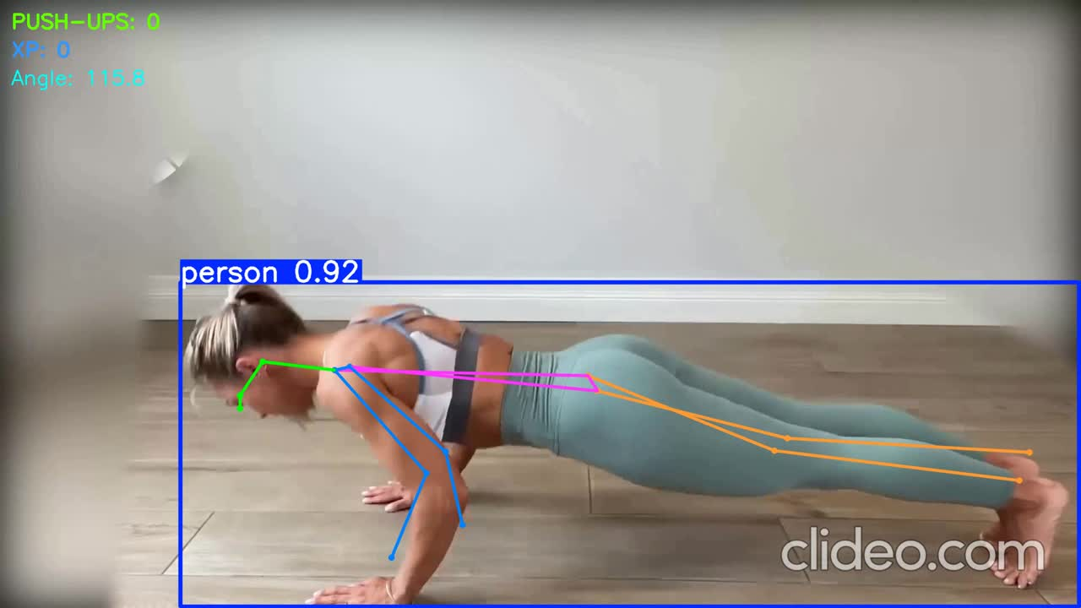
Pose-Based Exercise Tracking
Summary Snapshot (Auto-generated): Appears at the end of the video
Gives quick feedback without needing manual review
Pushup: Elbow angle monitored (from shoulder–elbow–wrist)
Notes:
💪 Slide 5: Pose-Based Exercise Tracking – Pushup
Script:
Let’s take a closer look at how we track pushups using joint angles.
In each frame, we calculate the angle formed by the shoulder–elbow–wrist joints.
When the angle drops below a certain threshold — around 110 degrees, we mark that as the “down” phase of the rep.
When it rises above 145 degrees, we mark the “up” phase.
A rep is only counted when we detect a full cycle: down → up.
To prevent false triggers due to jitter or noise, we use a moving average of the last few angle values.
This makes the system more stable and ensures it doesn’t miscount due to shaky movement or momentary pauses.
Additionally, the model tracks reps across the video timeline — and at the end, it generates a workout summary screen.
This summary helps users review their workout, track progress, and stay motivated.
In future versions, we also want to give real-time feedback — for instance, if someone’s form is off or the movement is incomplete, we won’t count the rep and will display a message encouraging them to correct it.

Slide 6
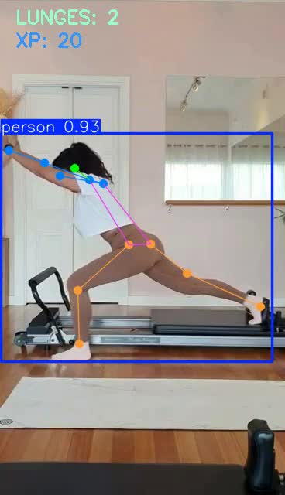
Pose-Based Exercise Tracking
Lunge: Knee angle monitored (from hip–knee–ankle)
Summary Snapshot (Auto-generated): Appears at the end of the video
Gives quick feedback without needing manual review

Slide 7
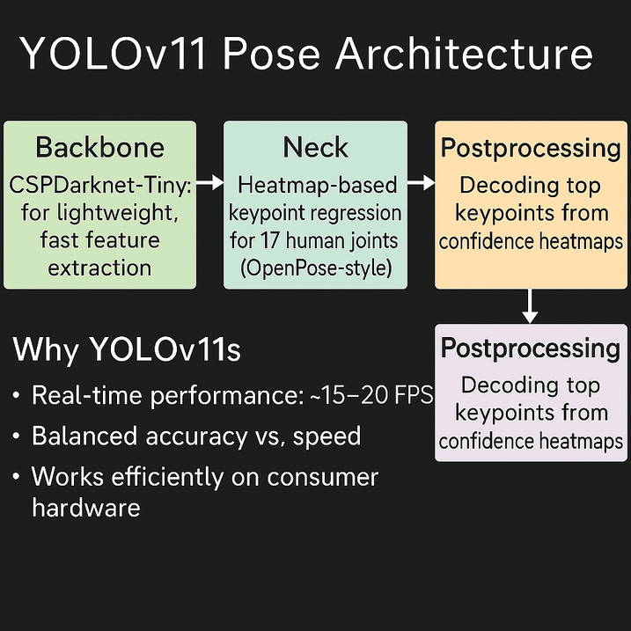
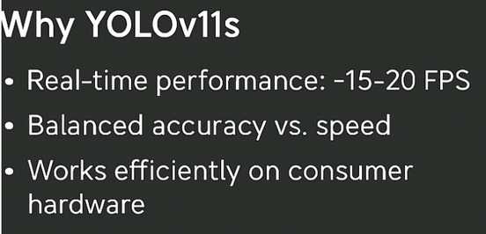
YOLOv11 Pose Architecture

Slide 8
Rep & Calorie Calculation Logic
Pushup Reps: Tracked elbow angle (Shoulder–Elbow–Wrist)
Counted when angle drops below 110° (down) and rises above 145° (up)
Smoothed using moving average over last 5 frames to avoid jitter
Lunge Reps: Tracked knee angle (Hip–Knee–Ankle)
Detected when angle drops below 135° (down) and rises above 155° (up)
Calorie Estimation Formula: Pushups: reps × 0.5 kcal
Lunges: reps × 0.3 kcal
Based on average MET estimates and adjusted for short-session dynamics

Slide 9
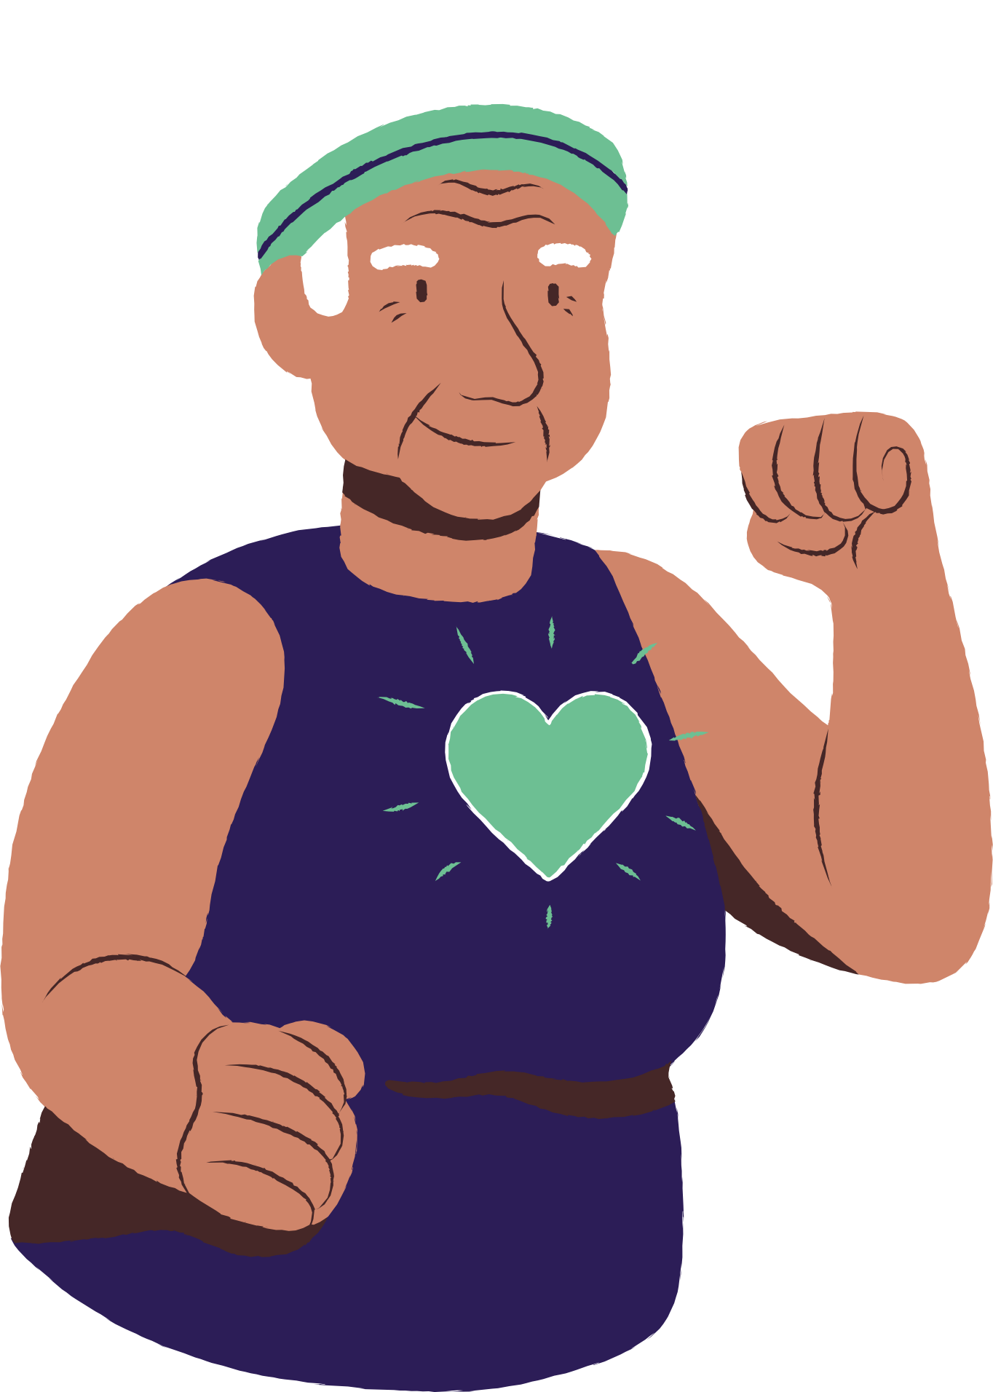
Future Actions
1
Multi-Exercise Support
Add more workouts like squats, planks, and jumping jacks.
2
Real-Time Feedback
Switch from video input to live workout feedback.
3
Rep Quality Filtering
Only count reps done with correct form; ignore bad reps.
4
User Profiles & Logs
Track sessions and show progress over time.

Slide 10
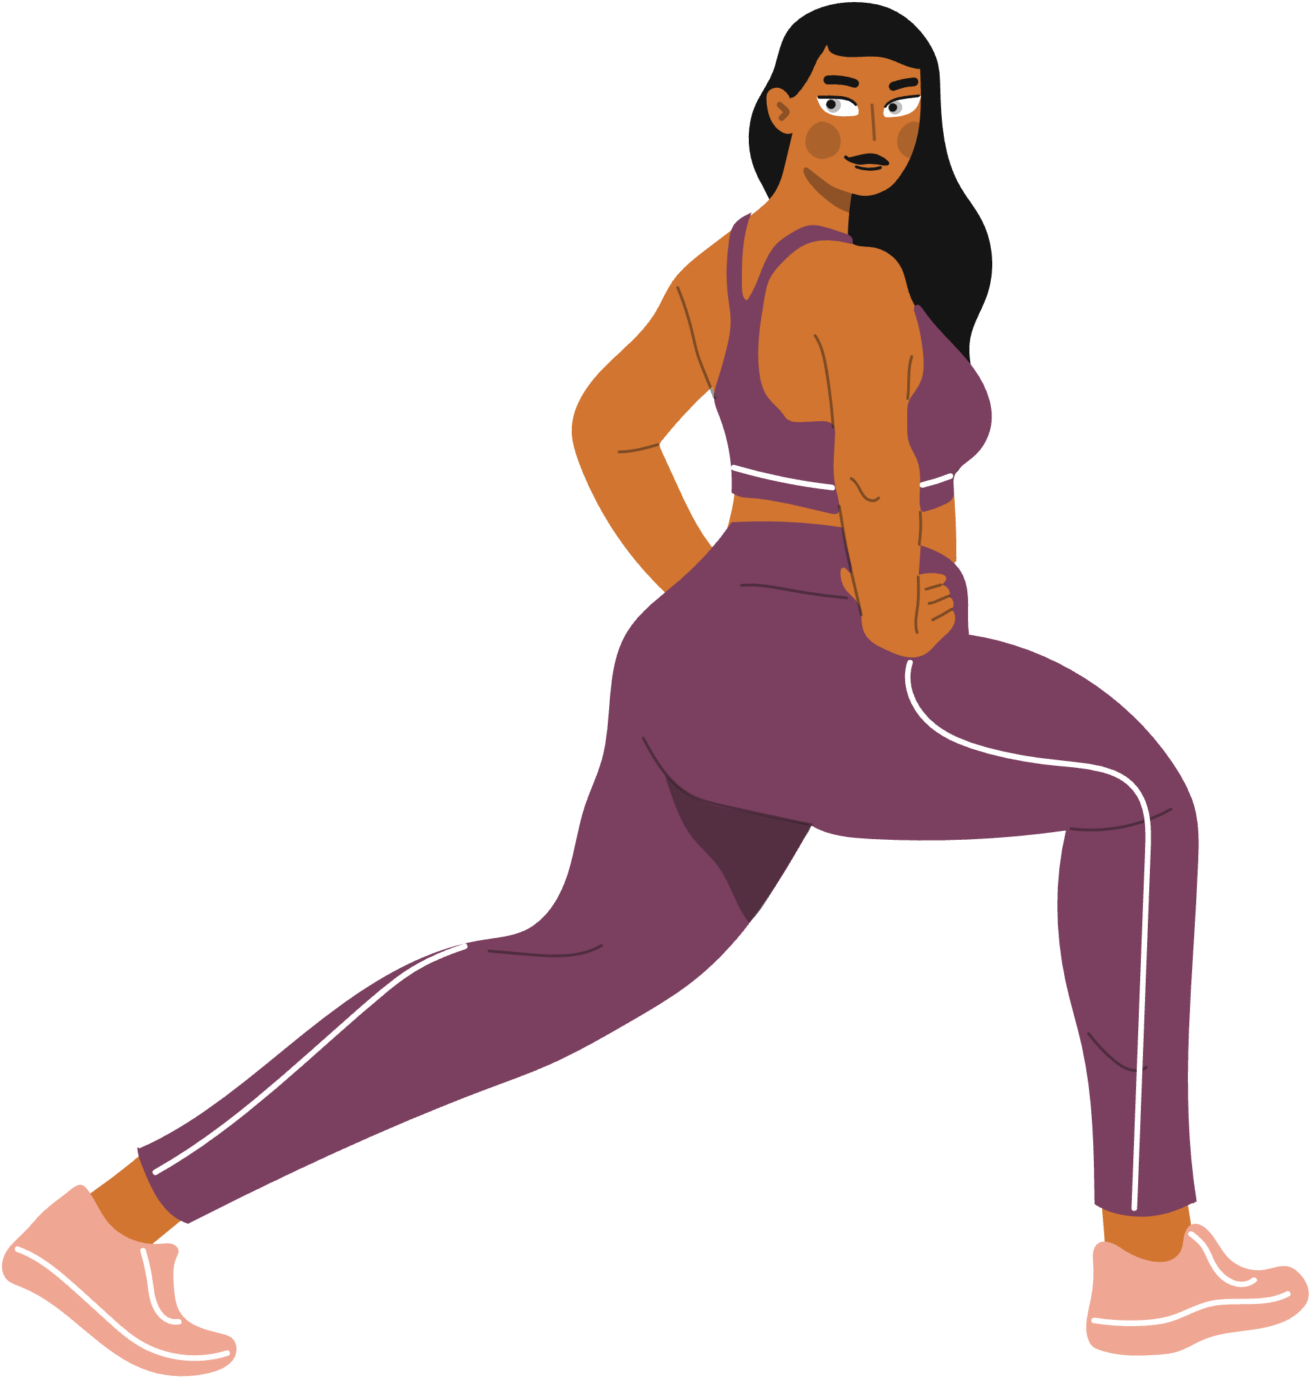
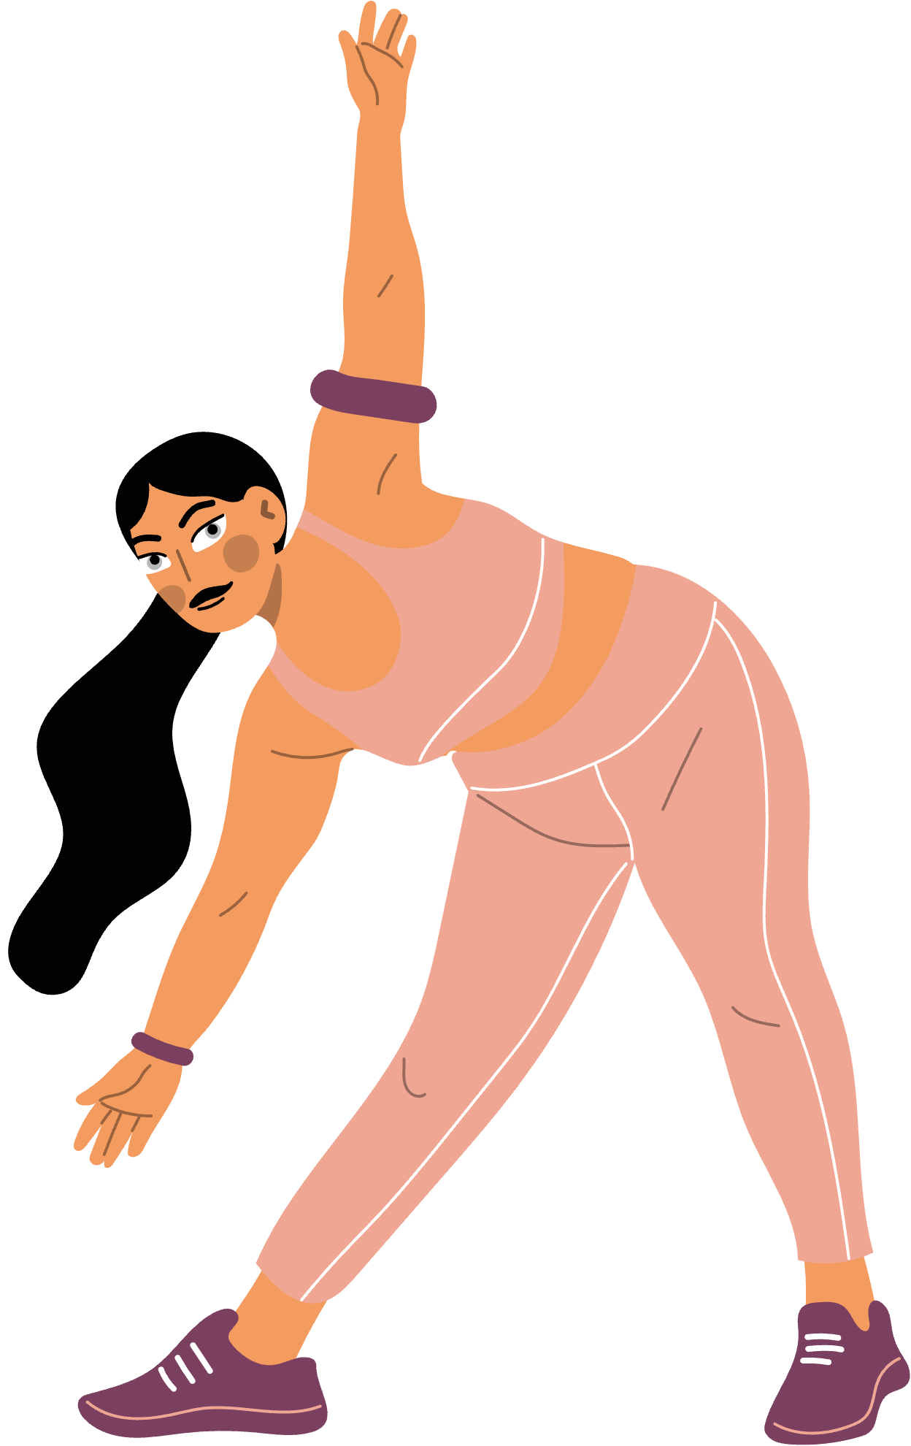
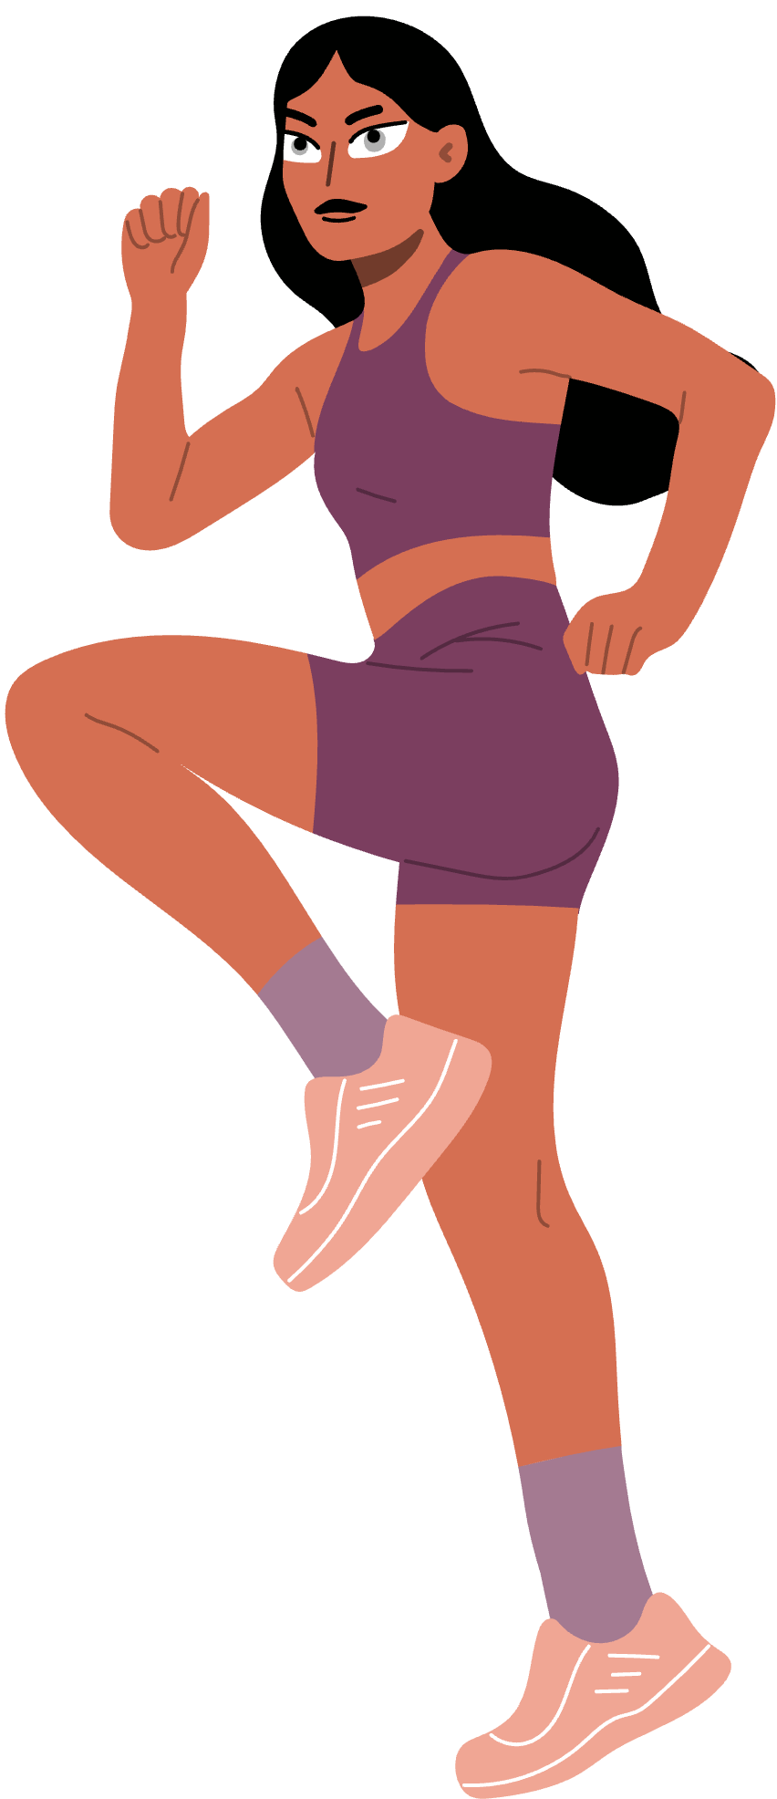
Thank You

